Slide 1

1st Checkpoint
GoMyCode
Web Fundamentals
Ben Rejeb Zied

Slide 2
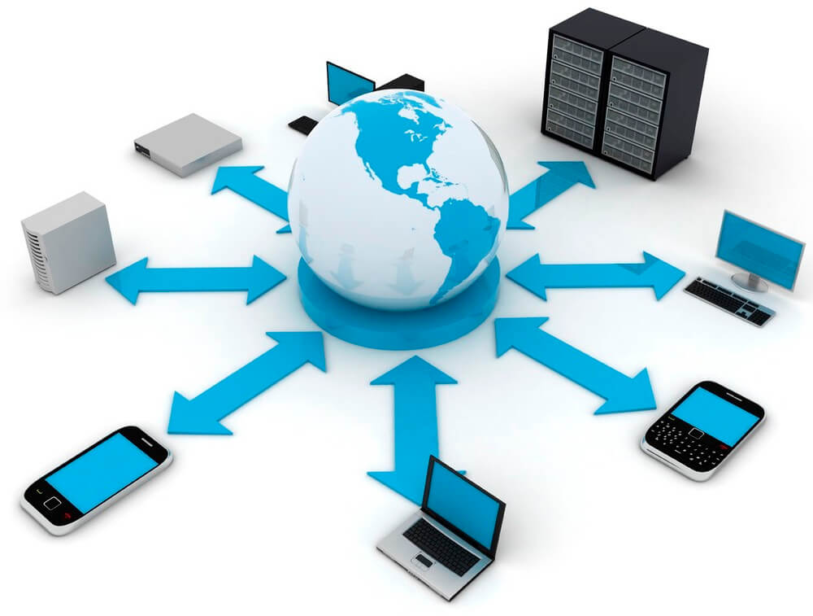
What is Web (WWW, W3)?
The World Wide Web -- also known as the web, WWW or W3 -- refers to all the public websites or pages that users can access on their local computers and other devices through the internet. These pages and documents are interconnected by means of hyperlinks that users click on for information.
This information can be in different formats, including text, images, audio and video.
The term World Wide Web isn't synonymous with the internet. Rather, the World Wide Web is part of the internet.

Slide 3
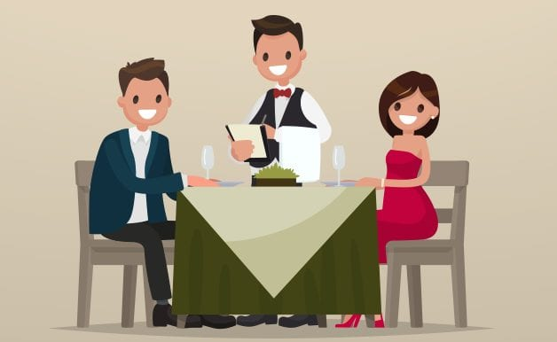
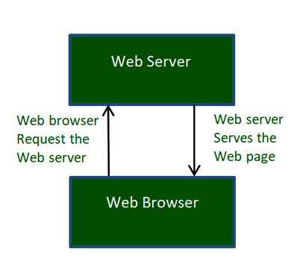
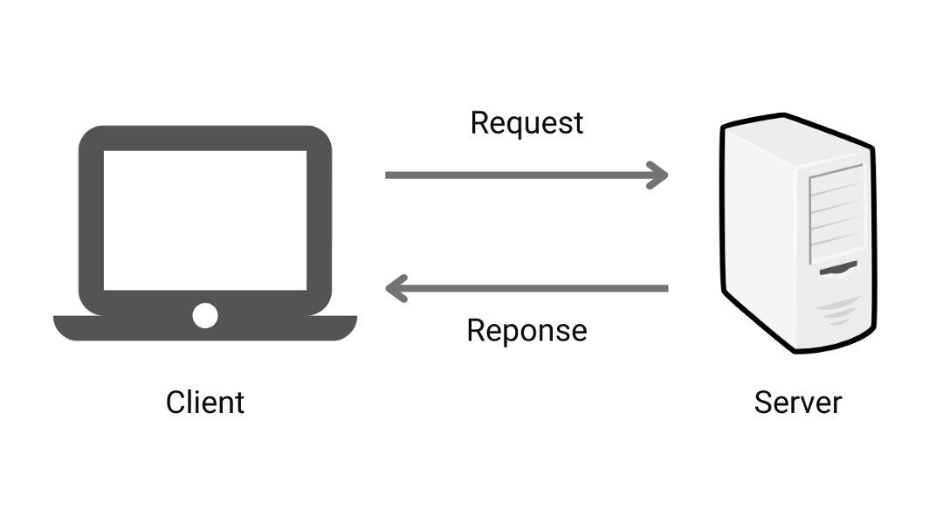
How does the web work?
The World Wide Web consists of multiple components that enable users to access various resources, documents and web pages on the internet. Thus, the WWW is like a vast electronic book whose pages are stored or hosted on different servers worldwide.
Client-Server model : The client which is your Computer, more specifically the browser you are using, sends a request to the Server to fetch the page you have entered in the address bar of the browser(URL) . The Server checks if the page exists, if it exists the server will send the HTML page in response and if it the requested page doesn’t exists then the server sends a 404 Error code which means the web page doesn’t exist on the server.

Slide 4
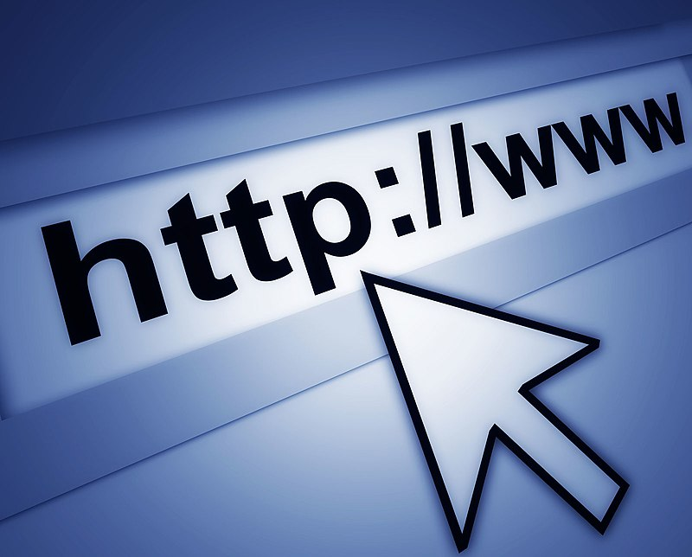
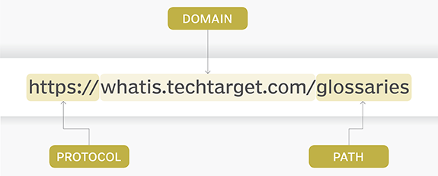
URL (Uniform Resource Locator) : is nothing more than the address of a given unique resource on the Web. In theory, each valid URL points to a unique resource. Such resources can be an HTML page, a CSS document, an image, etc.
Basic URL Structure : (URL structures can be different)
The protocol is how the browser gets the information about that page, either http:// or https:// (“s” stands for secure).
The domain name is the unique address where a website is located.
The path refers to the exact location of a page, post or file.

Slide 5



What a Web Developer need?
Computer literacy and programming knowledge
Have the spirit of the team
Disciplined
Clear explain for points and problems
motivated and hard working
A keen interest in technology and up to date
Strong creative ability and perfect reasoning
Control feelings well
Attention to detail and quick thought
Sportsmanlike

Slide 6

Why Web Development?
There is a voice in my mind always told me that am in the wrong way . I’ve always change the place but it doesn't help . I thought there is an attraction or a love story between me and my computer .
As long 5 years my pain increase every day . Away from the domain ,coding and technologies .but in my free time I was kind of faithful by following technologies news and updates.
I call it dream .I've tried to do my best since I was 24 but it doesn't work . This time I wish success and I’ll do my best because am free now .
I choose Web Development to find my spirit again and create my own world and find peace. Simply am born for this .

